Slide 1
Making Olist the Amazon of Brazil
Data Visualization and Storytelling
Group 6

Slide 2

Problem Overview
Olist connects small businesses from all over Brazil to channels without hassle and with a single contract. Those merchants can sell their products through the Olist Store and ship them directly to the customers using Olist logistics partners.
We have comprehensive data about: products, customers and sellers
To optimize the operations of Olist and increase their profitability, we analysed:
72 product categories
32951 products
3095 sellers
99,441 orders
96,096 customers

Slide 3
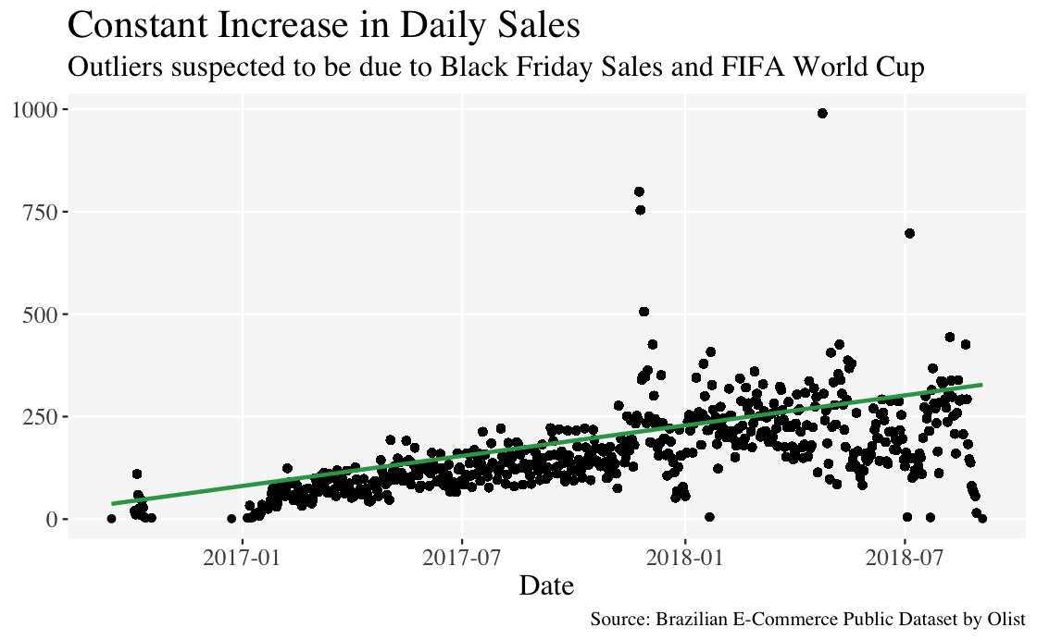
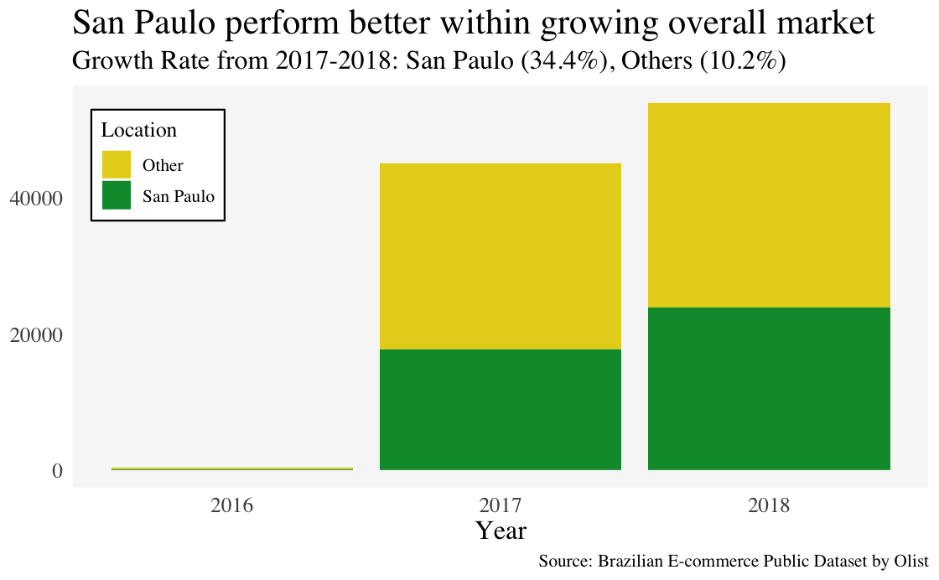
Has Olist been able to capture sales from 2016 to 2018?
FIFA World Cup
Black Friday sales
Growth Rate
San Paulo: 34.4%
Others: (10.2%)
19.8% increase in total number of orders
The e-commerce market in Brazil experienced increase from 2016 to 2018 and apart from a few outliers, Olist’s sales have been reflective of the same.
San Paulo has the most attractive growth prospects
While the overall volume increased, both order volume and growth rate in San Paulo are significantly higher than the rest of the regions

Slide 4
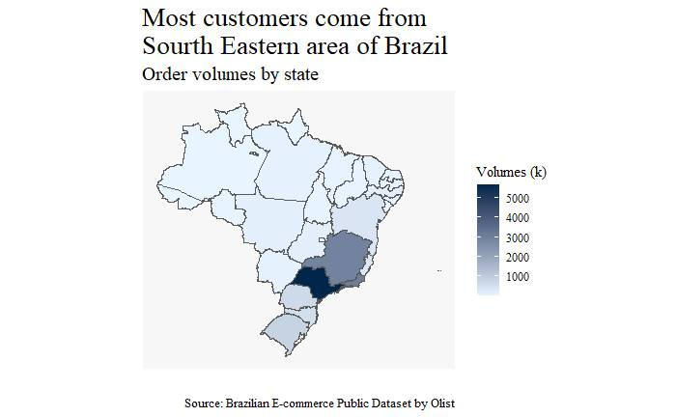
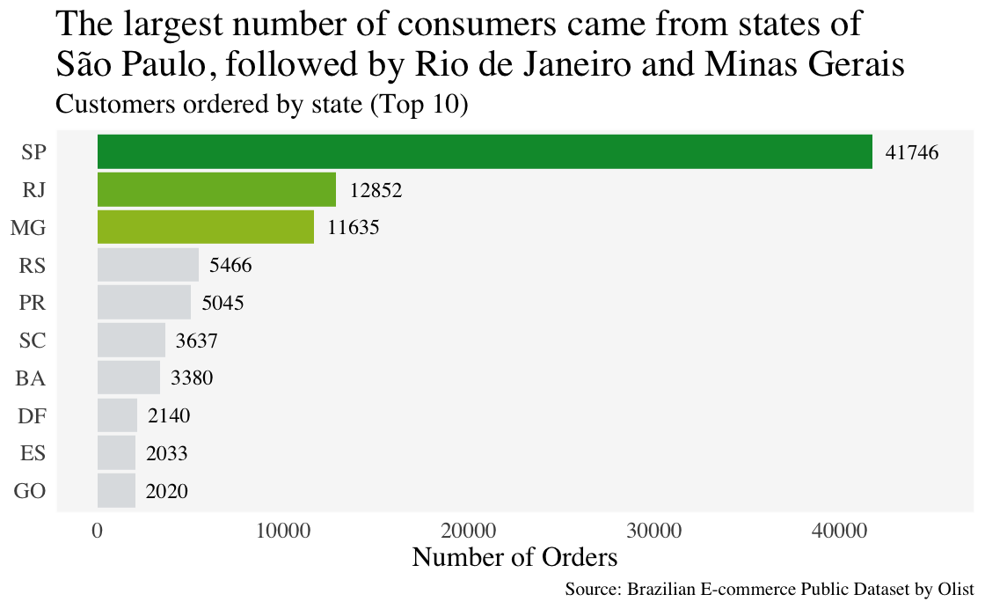
Which areas in Brazil generate the most orders?
Sao Paolo generates significantly more orders than rest of Brazil
Aligning with the growth rate, Sao Paolo has the most customers and thus, generates the most orders

Slide 5
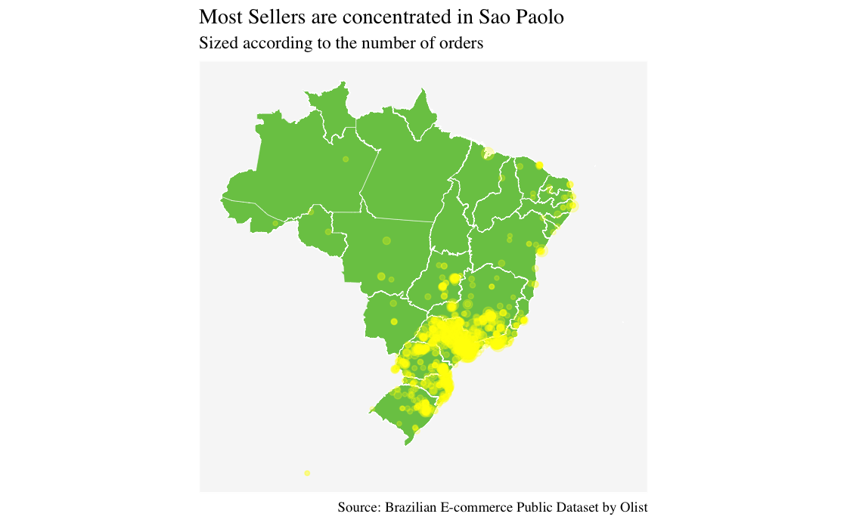
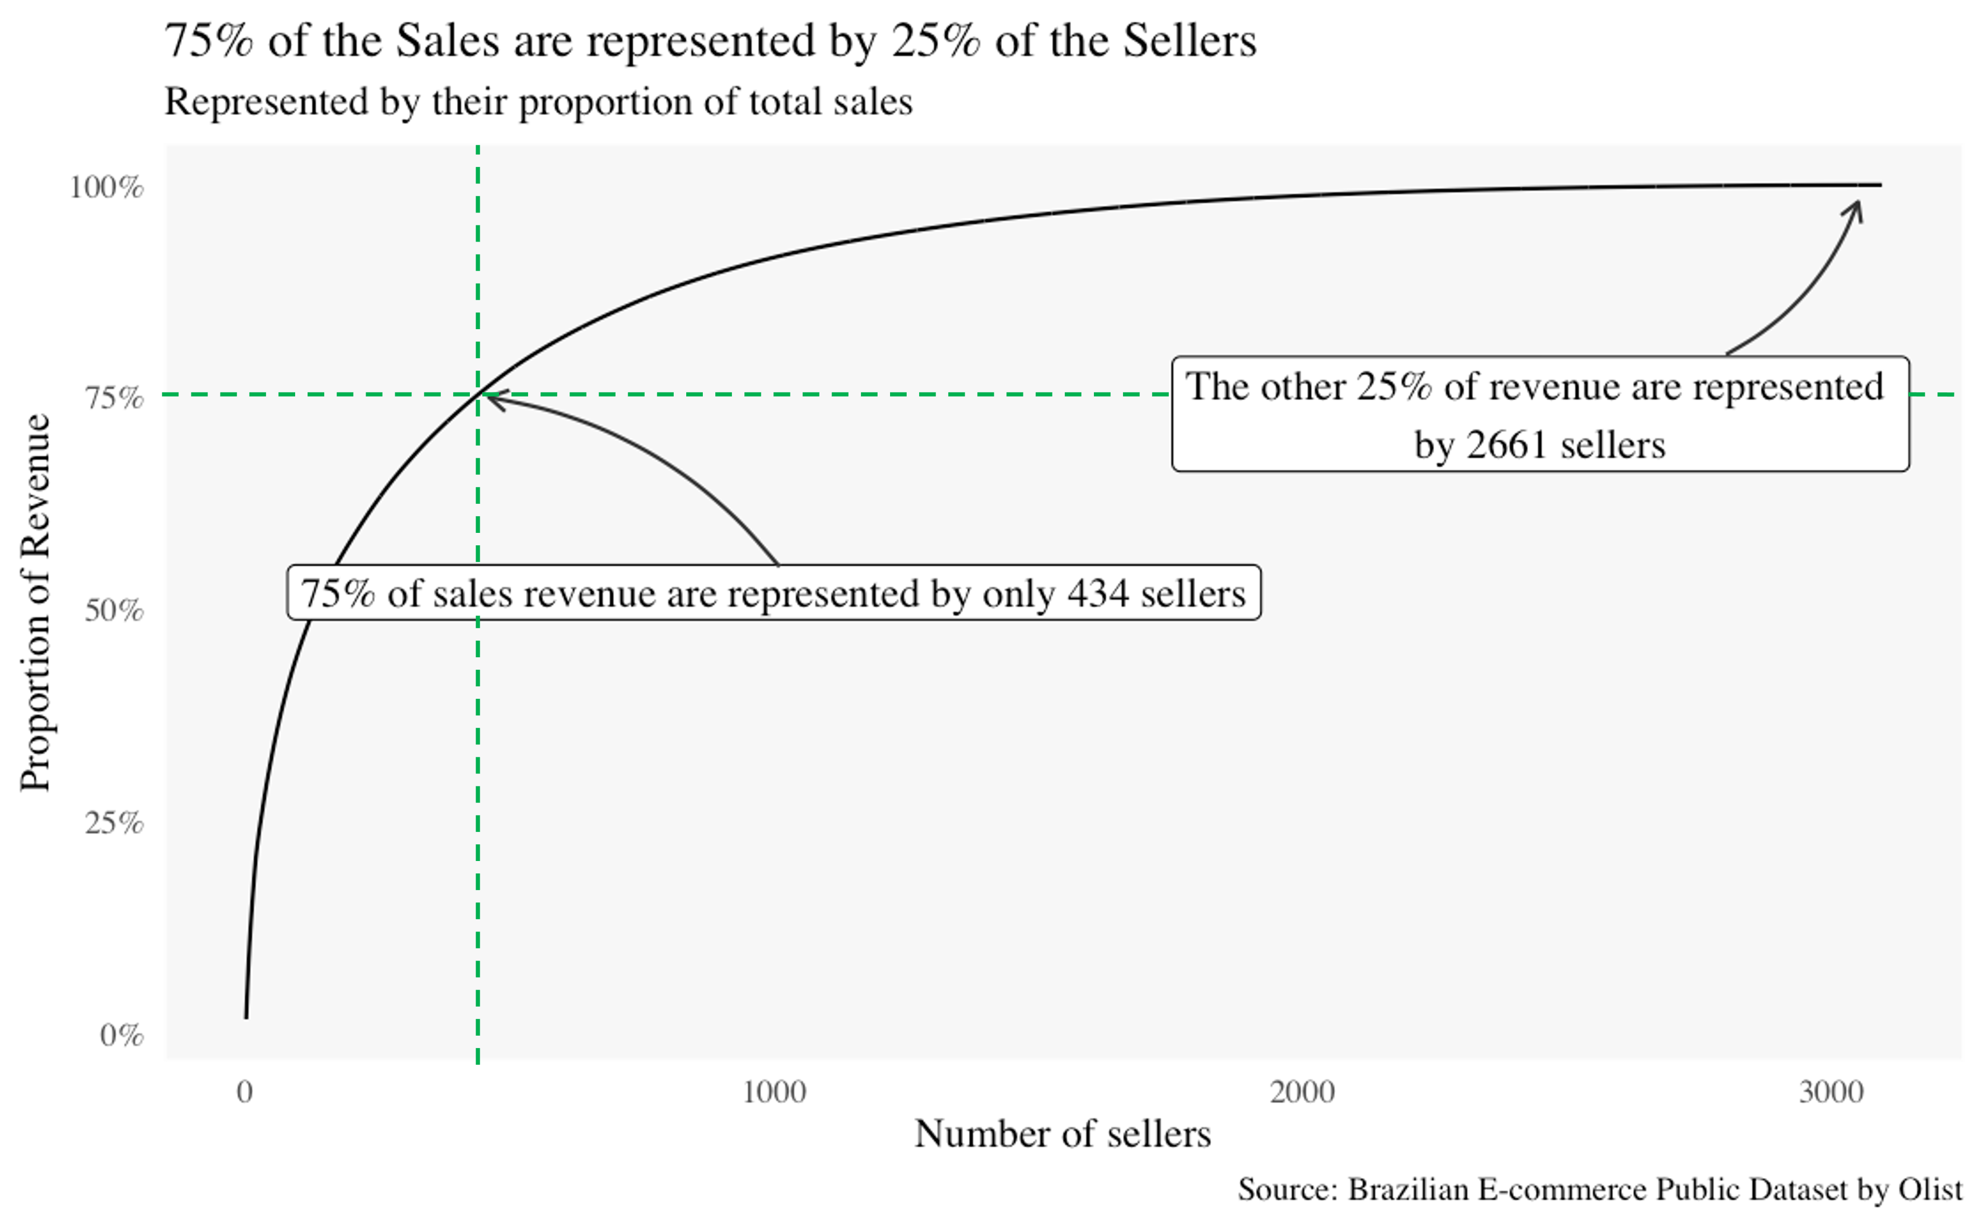
Are there enough sellers to fulfill the demands of the customers?
Most sellers are in Sao Paolo
Following the pareto principle, 25% of the sellers, fulfill 75% of the demand in Brazil. Also, most sellers are in southeastern region, where majority of the customers are also concentrated.

Slide 6
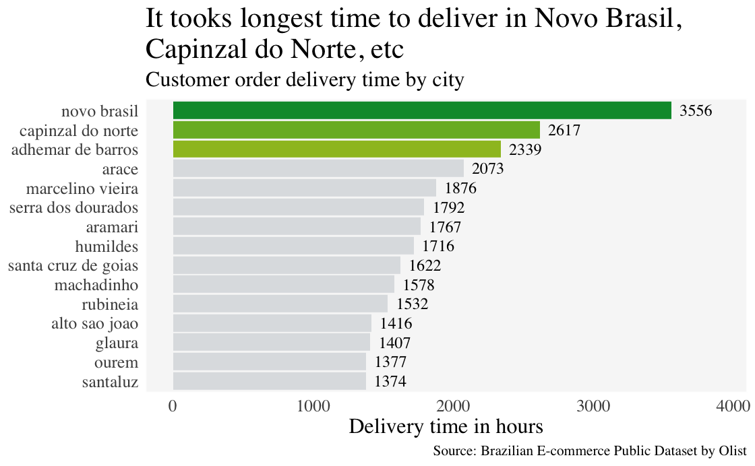
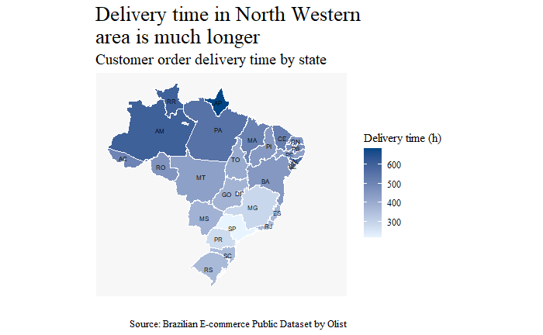
Has Olist been able to maximise its synergized customer and seller network?
Olist has a strong distribution network in Southeastern Region
Olist has been able to develop a strong distribution network in its most popular region and thus, is able to maintain is strong customer base in Sao Paolo and neighbouring areas.

Slide 7
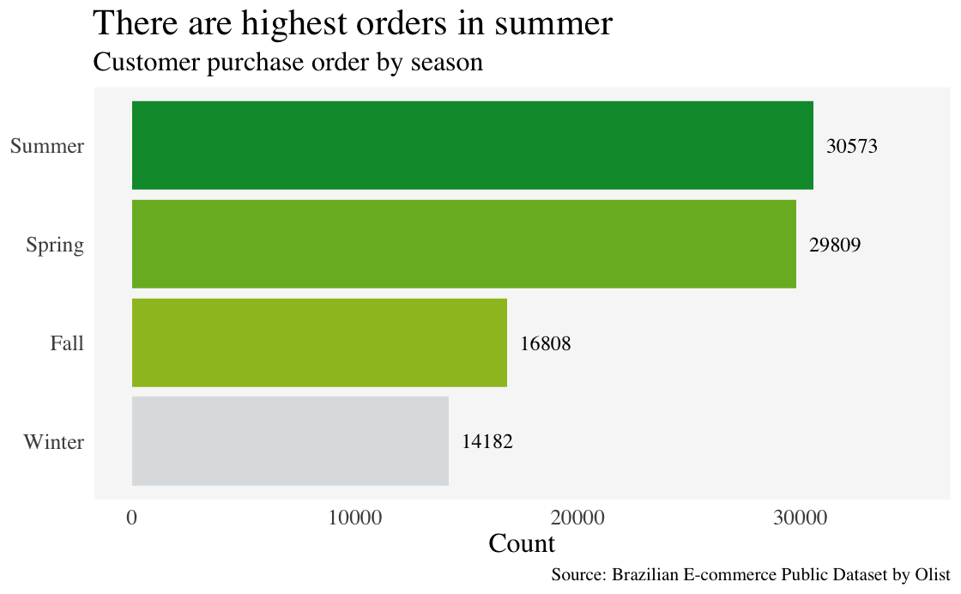
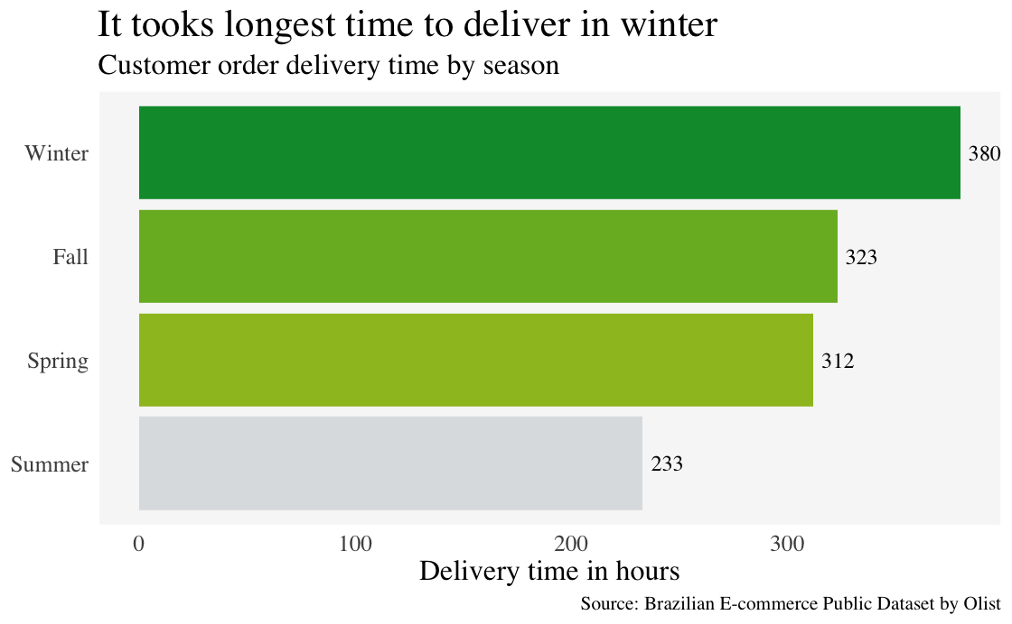
Is there seasonality in terms of number of orders?
Olist receives more orders in Summer and Spring
This could be attributed to the longer delivery time during winter and fall. While there could be external factors contributing to the delay like heavy rain during fall and winter, Olist can work towards improving its services during this time.

Slide 8
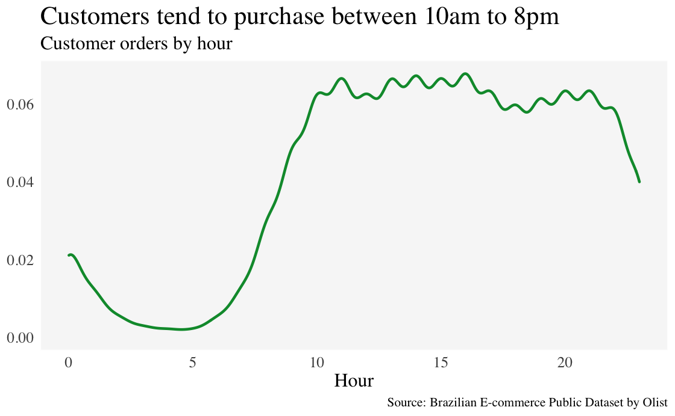
Is there a particular time in the day, when orders are more?
There are more orders during the afternoon than the evening
Contrary to expectation, there are more orders during work hours than the rest of the day. This could indicate that home makers or high schoolers could be bulk of the customers.

Slide 9
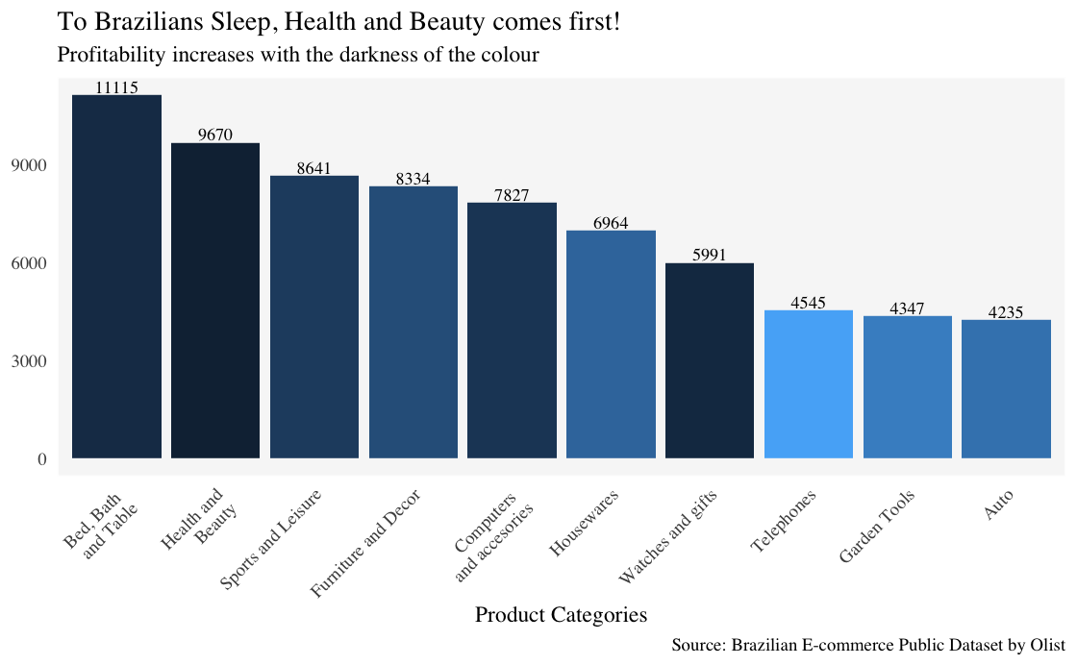
Of all the products sold, which are the most popular in Sao Paolo?
While bed and bath products are sold the most by order quantity, beauty and health products generate the most revenue
Given Sao Paolo has the most customers, we analysed the most popular product in terms of both number of orders and total revenue generated. Assuming homemakers and non-working adolescents and high schoolers are majority of the customer, it would explain the sale of health & beauty products.

Slide 10
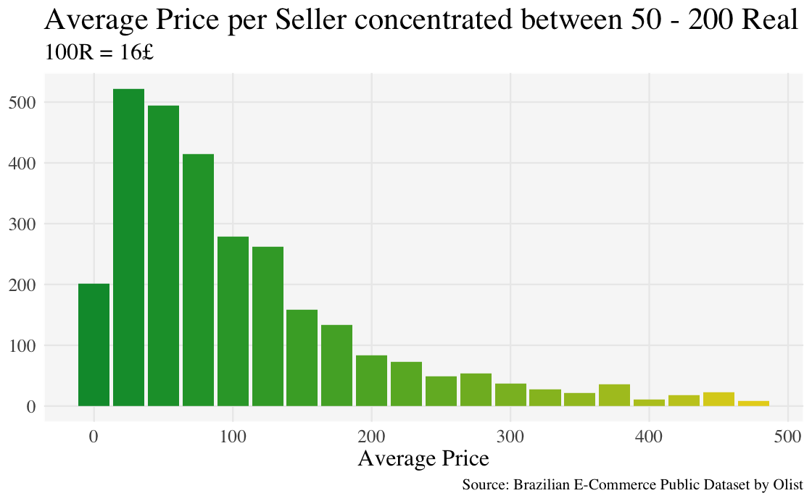
Is the order value skewed by high priced items?
Most orders are between £8 to £32
Most of the orders fall in the affordable range.

Slide 11
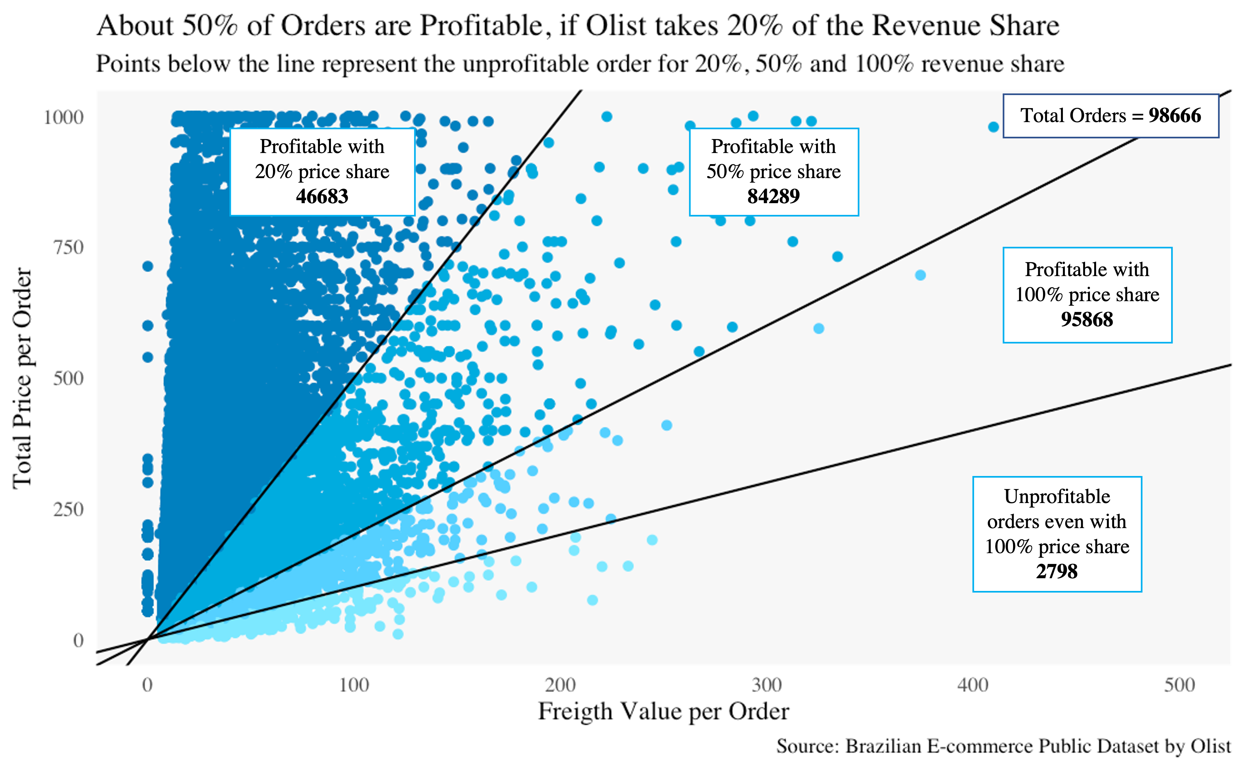
Are all orders generated, profitable for Olist?
We assume various scenarios of different price share agreements between the sellers and Olist, and calculate how many orders are profitable, given the freight value of each order, borne by Olist.
Olist must optimize its distribution channels to reduce the freight costs.
Olist must create a model to overcome the sum cost of freight by its total revenue generated out of all orders.

